Slide 1
Week 5 Live Session
Wendy Christensen, Ph.D.
COMP 4442
Spring 2021

Slide 2
Agenda
Course logistics
Participation exercise review
Forward selection demo
Problem Set 4 questions
Odds and probability review
Logistic regression
Problem Set 5 and midterm overview

Slide 3
Upcoming deadlines (all 11:59 p.m. MDT)
Week 4 Participation: Due Sunday, 4/25 (past due, please get these in)
Problem Set 4: Due this Friday, 4/30
Week 5 Participation: Due this Sunday, 5/2
Assigned today: Midterm exam, due Friday, 5/7 (next Friday)
Problem Set 5, due Friday, 5/14 (next next Friday)

Slide 4
Odds and probabilities
Probability of Action A when Event A occurs: a/(a+c)
Odds of Action A when Event A occurs: a/c
 | Action A | Action B
Event A | a | b
Event B | c | d

Slide 5
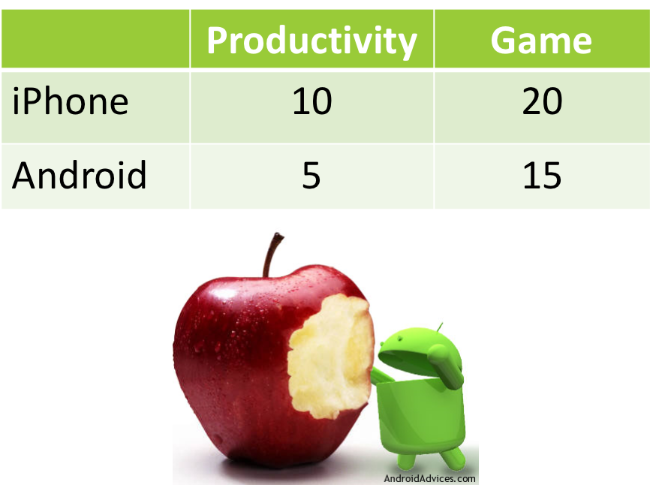
Odds and probabilities
Each relationship has two associated odds: One less than 1, and the other greater than 1
Let’s say that iPhone users and Android users were asked if they purchased either a productivity app or a game app.

Slide 6
Odds and probabilities
It is possible to convert between probability and odds:
For iPhone users, the probability of buying a productivity app is 10/30 = 0.33
For iPhone users, the odds of buying a productivity app are 10/20 = 0.5
P = odds/(1+odds) = 0.5/(1+0.5) = 0.5/1.5 = 0.33, Matches!
Odds = P/(1 - P) = 0.33 / (1 - 0.33) = 0.5 (will match if enough digits are included)

Slide 7
Odds ratios
Odds ratios are expressions of association, which are calculated using the ratio of two odds.
If both inputs have the same odds - that is, they’re equally likely - then the odds ratio will be 1.
These are generally more useful than using odds alone.

Slide 8
Odds ratios
What is the odds ratio for purchasing a productivity app vs a game app for iPhone purchases (using game as the denominator)?
2/1.33 = 1.50
The odds of an iPhone app purchase are 1.50 times greater for a productivity app than a game app
 | Productivity | Game
iPhone | Prob: 0.67 Odds: 2 | Prob: 0.57 Odds: 1.33
Android | Prob: 0.33 Odds: 0.5 | Prob: 0.43 Odds: 0.75

Slide 9
Odds ratios
What is the odds ratio for iPhone vs Android purchases of game apps?
1.33/0.75 = 1.77
The odds of a game app purchase are 1.77 times more likely from an iPhone than an Android phone.
 | Productivity | Game
iPhone | Prob: 0.67 Odds: 2 | Prob: 0.57 Odds: 1.33
Android | Prob: 0.33 Odds: 0.5 | Prob: 0.43 Odds: 0.75

Slide 10
Logistic regression

Slide 11
Logistic regression
Logistic regression is used when the outcome is a two-category outcome (a.k.a. binary, dichotomous). These are coded as 0 (“failure”) and 1 (“success”) for analysis purposes. Although numeric, the outcome is not continuous and thus cannot be used as the outcome in a multiple regression.
This type of regression is “logistic” because a logistic function is used as the link function. Other types of link functions for binary outcomes exist, (e.g., probit functions), but logistic regression is very popular. Logistic regression is a type of generalized linear model, which uses different link functions to loosen the distribution assumptions of the residuals.

Slide 12
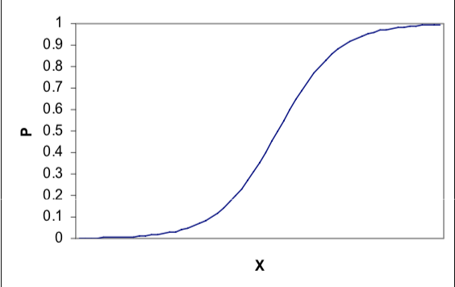
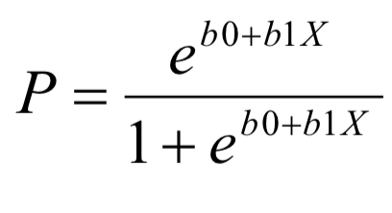

Logistic regression - link function
Much like in normal regression, we can use a set of variables to predict the probability of an outcome.

Slide 13
Logistic regression - link function
Notice that the exponents in the numerator and denominator contain a recognizable linear regression equation - in this case, it contains just one predictor.

Slide 14
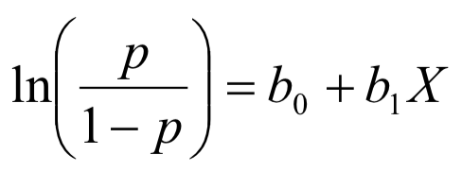
Logistic regression - linearization
With some laborious rearranging, this function can be linearized like so:
This formulation is much more estimable than the original function because the b’s are now linear terms instead of exponentiated terms.
Although logistic models are computationally more complex than linear regression models, the output ends up looking a lot like what you’ve already seen.

Slide 15
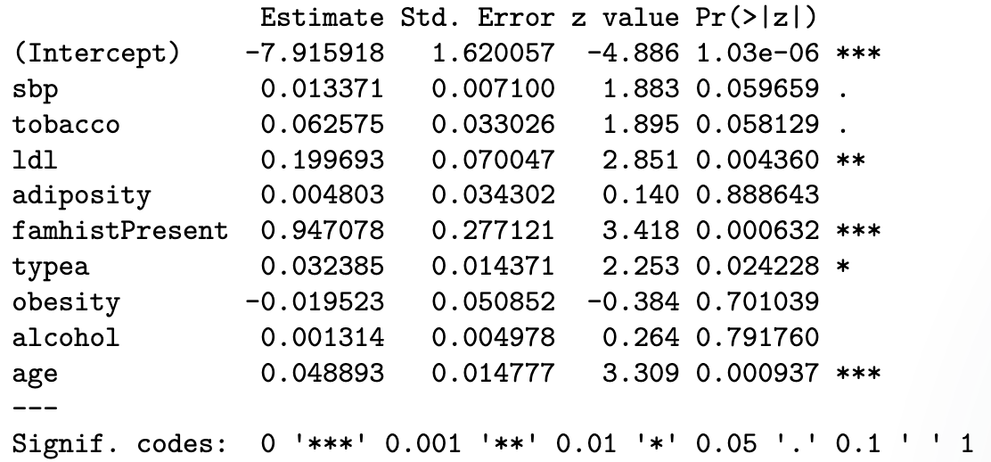
Logistic regression - output
The predicted outcome is now in terms of log odds (sometimes called “logits”). Accordingly, the model coefficients are interpreted as the expected/predicted change in the log odds of Y for a one-unit increase/decrease in the predictor variable.
The p-values retain their usual meaning.

Slide 16
Logistic regression - interpretation example 1
Family history is a significant predictor of having a CHD diagnosis (p < 0.05).
Holding all other variables constant, having a family history of CHD increases the predicted log-odds of a CHD diagnosis by 0.947078 compared to someone with no such history.

Slide 17
Logistic regression - interpretation example 1
It’s common for a less formal interpretation of the coefficients to be used in practice:
“Holding other variables constant, a person with a family history of CHD is more likely to have a diagnosis of CHD.”
Positive coefficient = more likely Negative coefficient = less likely

Slide 18
Logistic regression - interpretation example 2
Age is a significant predictor of having a CHD diagnosis (p < 0.05).
Holding all other variables constant, each additional year of age increases the predicted log-odds of a CHD diagnosis by 0.048893.
Or, holding all other variables constant, a CHD diagnosis is more likely as people get older.

Slide 19
Logistic regression - variable selection
You can apply the same variable selection techniques to logistic regression as you learned for multiple regression: forward selection, backward selection, best subsets selection, stepwise selection, information criteria, etc.
You can also do nested model testing, but an F-change test isn’t appropriate for logistic regression. Rather, you should use a likelihood ratio test, which uses a chi-square distribution. The R function for this is the lrtest() function, which behaves similarly to the anova() function.

Slide 20
Logistic regression - model fit
Indices of model fit are different than those used in regression (e.g., R-squared) because of the nature of the outcome. “Pseudo R-square” measures do exist (e.g., Nagelkerke R-square), but none are a standard in the same way that R-squared and adjusted R-squared are.
The binary nature of the outcome offers an alternative way to assess model fit: the confusion matrix. This is a table that compares the actual binary outcome with the binary prediction of that outcome.

Slide 21
Logistic regression - model fit
With confusion matrices, it is very important that you know what your axes mean. This particular table has the actual outcomes as the rows and the predicted outcomes as the columns, but others may have them reversed.
 | Predicted outcome
Actual outcome |  | 0 | 1
 | 0 | True negative (TN) | False positive (FP)
 | 1 | False negative (FN) | True positive (TP)

Slide 22
Logistic regression - model fit
There are many indices of model fit that have been developed for binary outcomes. Here are four:
Accuracy: (TN + TP) / (TN + FN + TP + FP)
Precision: TP / (TP + FP) <- denom is all positive predictions
Recall: TP / (TP + FN) <- denom is all actual positives
F1 score: 2 * [(Precision * Recall) / (Precision + Recall)]
Notes:
F1 score is the harmonic mean of precision and recall

